Slide 1

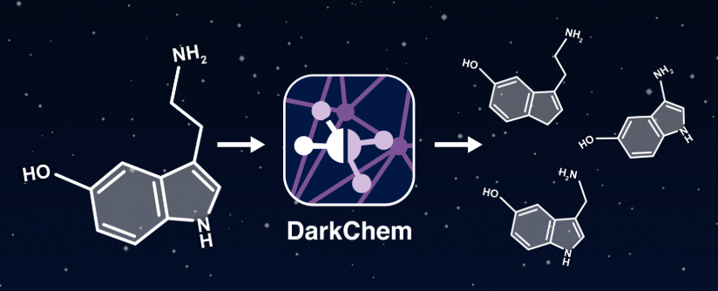
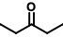
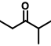
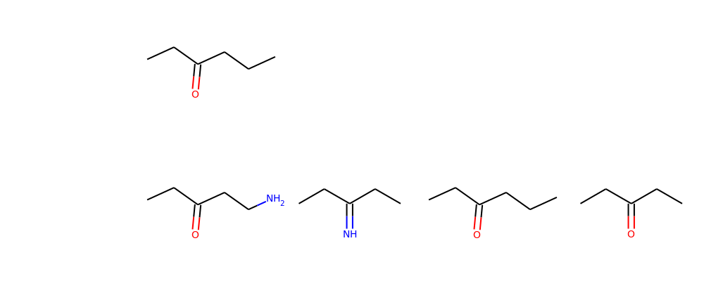
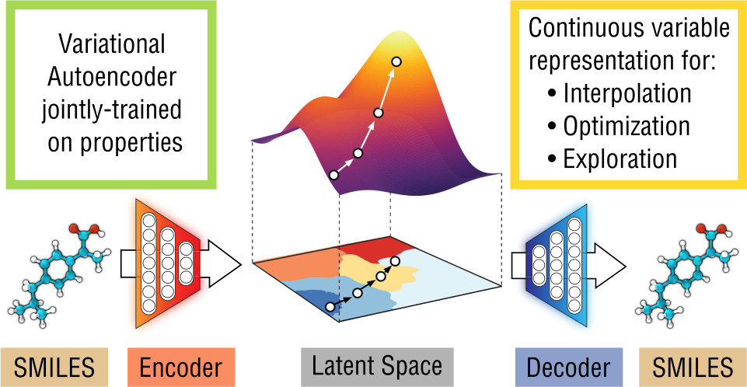


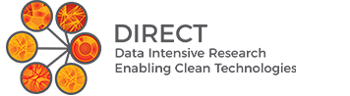
Generating Novel Molecules Using Latent Dimension Reaction Manifolds from Deep Learning
Christine Chang¹, Chih-Wei Hsu², Liang Xu¹, Ryan Renslow³, Sean Colby³
1Department of Materials Science and Engineering, 2Department of Chemical Engineering; University of Washington, Seattle, WA
³Pacific Northwest National Laboratory, Richland, WA
Background
Package Flowchart
Results
Load model
ENOLATE ALKYLATION
Training set: 12 reactions
Testing set: 1 reaction
Load data
Latent Space
Testing set
Vector
Reactant
Expected Product
Predicted Product
DarkChem is a variational autoencoder (VAE) built at the Pacific Northwest National Laboratory (PNNL).
Data cleaning
Split
DarkNight( )
Vector
REDUCTION OF ALKENES
Training set: 46 reactions
Testing set: 10 reactions
FEATURES
Encodes charge-mass ratio (m/z) and collision cross-section (CCS) for ~700,000 molecules
High reconstruction accuracy (~99%)
Training set
Vector
DEPENDENCES (PYTHON 3.6)
Darkchem
NumPy
Pandas
RDKit
Keras (TensorFlow backend)
Only 1 bad prediction! (90% accuracy)
Prediction
Model
Output
Aromatic cycles containing N: 70% accuracy
VAE Image: Gómez-Bombarelli, R.; Wei, J.N.; Duvenaud, D.; Hernández-Lobato, J.M.; Sheberla, D.; Aspuru-Guzik, A. et al. ACS Cent. Sci. 2018
Assessing Candidate Chemical Reactions
Training Set
Test Set
DarkNight
Reaction Vector
(Average of Σ(P – R) Vectors)
Test Reactant
GOALS
Determine how chemical transformations are represented in latent space
Use latent space to predict products and product properties of chemical reactions
Chemical Structures
(Reactants, Products)
Canonical SMILES Strings
(OpenBabel)
Structural Arrays
utils.struct2vec
Latent Space Vectors
model.encoder.predict
Conclusions and Future Work
Predicted Product
Successful prediction for certain reactions (up to 90% accuracy)
Some errors persist in predictions (e.g. extra C atom issue)
FUTURE WORK
Larger testing sets (roadblock: must be manually generated)
Classification of reactants to improve accuracy
USE CASES
Predict unknown product(s) in a reaction, as well as the properties of the product(s).
Input(s): Reactant , Reaction
Output(s): Product, Product Properties
Predict the structure of a small molecule given desired molecular properties.
Input(s): Desired Properties
Output(s): Product matching specified properties
Predict properties for a new or unknown molecule given its structure.
Input(s): Product
Output(s): Predicted Properties
Check: Are structural arrays are contained within DarkChem training set?
Compare with expected product
DarkNight:
Accuracy
Acknowledgments
References
The authors acknowledge the Renslow group at the Pacific Northwest National Laboratory, including Jamie Nuñez, as well as University of Washington DIRECT program, especially Dr. David Beck and Theodore Cohen, for their support. Only open-source packages were used in this work.
S.M. Colby, J.R. Nuñez, N. O. Hodas, C. D. Corley, R. R. Renslow. Deep learning to generate in silico CCS libraries and candidate molecules with specified IMS-MS properties. In preparation.

